Slide 1


Introduction to Unifrog:
For Parents

Slide 2

What is Unifrog?
Unifrog believe that destinations - where students end up after school - is even more important than their academic performance. They partner with schools to support students to progress into the best opportunity for them.
Unifrog do this by providing a one-stop-shop where students can explore their interests, then find and successfully apply for their best next-step after school.

Slide 3
The Unifrog tools
Access all tools on Unifrog to learn what options are available, access good quality information, and search for opportunities to support your child.
Recording what you’ve done
Searching for opportunities
Drafting application materials
Making applications
Quizzes
Exploring pathways
Interests profile
Careers library
Activities
UK universities
UK Personal Statement
Post 18 Intentions
Personality profile
Subjects library
Skills
US universities
Classes
Locker
Work environments profile
Know-how library
Interactions
European universities
Subject References
Applications list
MOOC
Oxbridge
CV / Resumé
Skills profile
Webinars
Canadian universities
Writing tool
Read, Watch, Listen
Asian universities
Common App Essay
Australasian universities
US recommenders
MidEast and Africa unis
Notes for Reference writers
Irish universities
Special Opportunities
Events

Slide 4
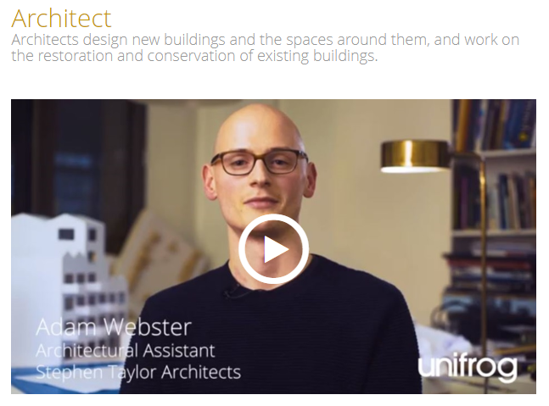
Careers library
Over 1000 career profiles
Presents information from a range of sources, including local and national LMI
Includes qualifications and skills needed, interviews with industry professionals and labour market information
Explores progression opportunities and what a working week really looks like

Slide 5
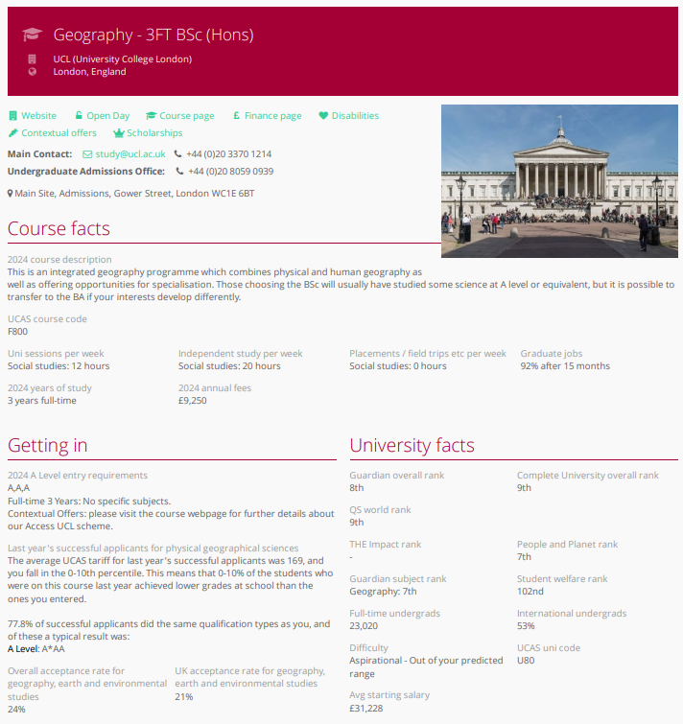
UK Universities
Students can enter subject of interest and projected grades to see all relevant university courses available in the UK
Rank and filter opportunities by factors like hours of lectures, price of accommodation and graduate job rates
Get direct links to university information pages, with impartial information on courses and institutions
Save unlimited shortlists to refer back to later

Slide 6
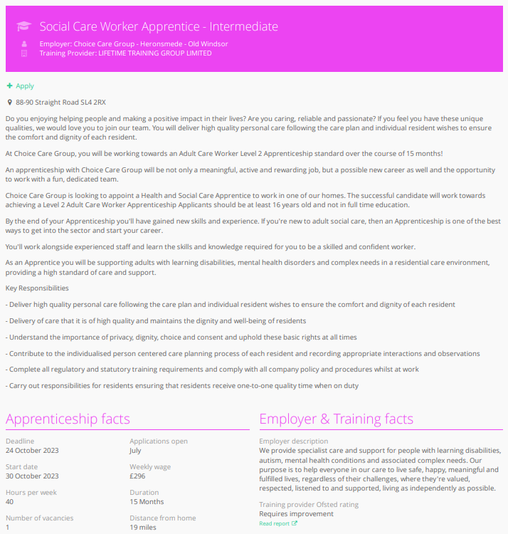
Apprenticeships
Students can find live apprenticeship vacancies
Vacancies are updated daily
Rank and filter opportunities by factors like distance from home, weekly wage and application deadlines
Direct link to the ‘apply’ page
Each apprenticeship vacancy includes practical information about the opportunity, employer and training
Save unlimited shortlists to refer back to later

Slide 7
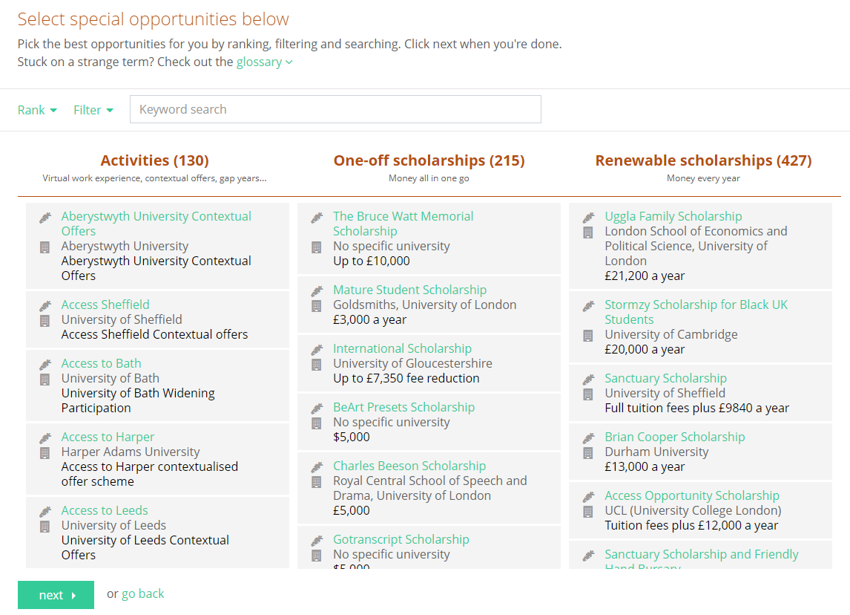
Special Opportunities
Includes £5 million-worth of grants, bursaries, scholarships, contextual offers and extracurricular activities
These can be filtered by circumstances or characteristics, depending on the access requirements of the opportunity
Includes direct links for applying
Unlimited shortlists can be created and referred back to

Slide 8
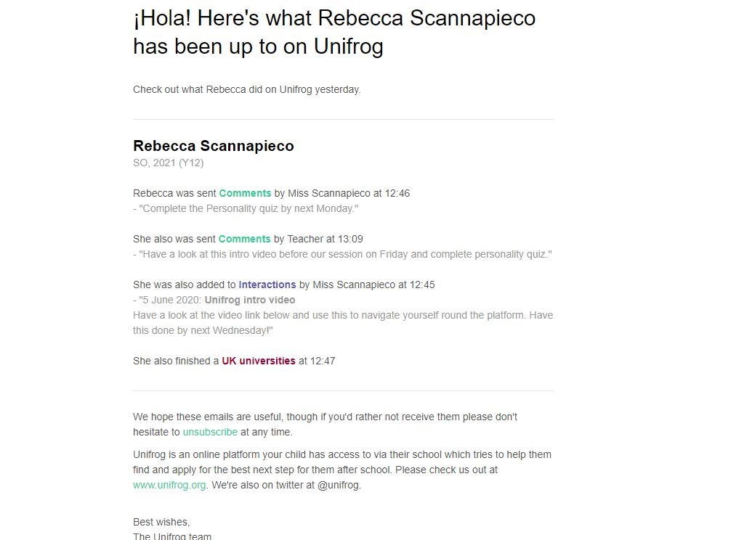
Weekly summary emails
Parents can sign up to receive weekly summary emails
This summary will show you any shortlists your child may have made on the Unifrog platform
It will also detail any interactions logged against your child, such as Careers Fairs taking place or careers interviews coming up
Notes:
Please note that these summary emails will only be sent out to parents if the school links parent accounts.
To do this, please fill in this spreadsheet: https://www.unifrog.org/downloads/update-student-parents.csv?07092022 and send it to the Partner Success Team: info@unifrog.org.

Slide 9
GDPR
GDPR is a regulation in EU law on data protection and privacy for everyone within the European Union and the European Economic Area.
Unifrog takes data security very seriously, and as such, has several features in place to protect school and student data.
We only use EU data centres, have multiple firewalls, layered-access security and more. Information on this can be found at unifrog.org/about#security
Notes:
Unifrog’s privacy policy can be found here: https://www.unifrog.org/privacy-policy
Service terms can be found here: https://www.unifrog.org/website-terms

Slide 10
Other cool stuff
The Unifrog platform contains so much more than what we can show you today, that was just four of their many tools.
So why not see for yourself? Sign up as a student and access the tools in exactly the same way that the students do.
You never know, there might be a new career just around the corner!

Slide 11
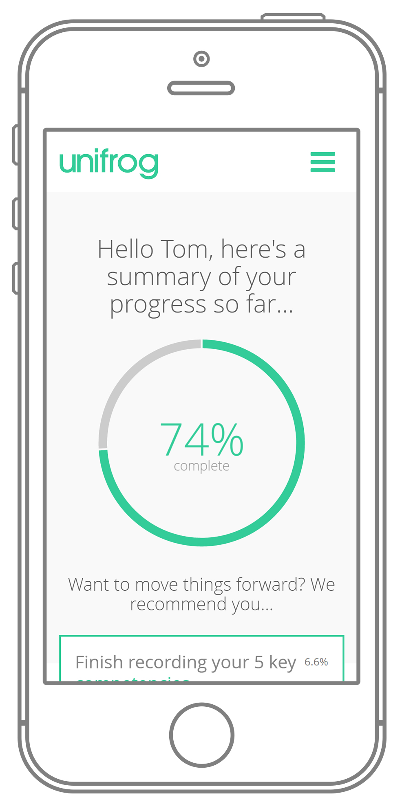
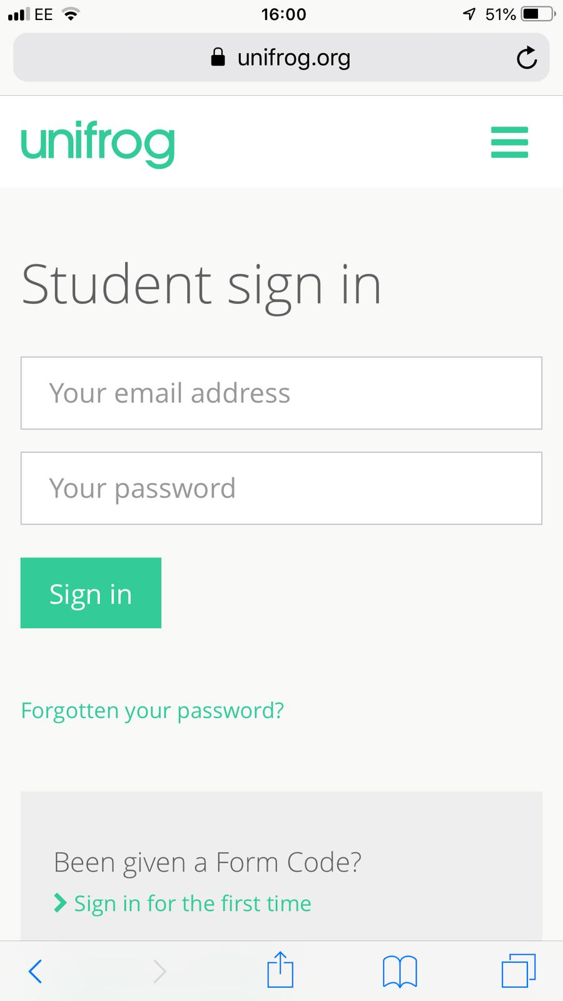
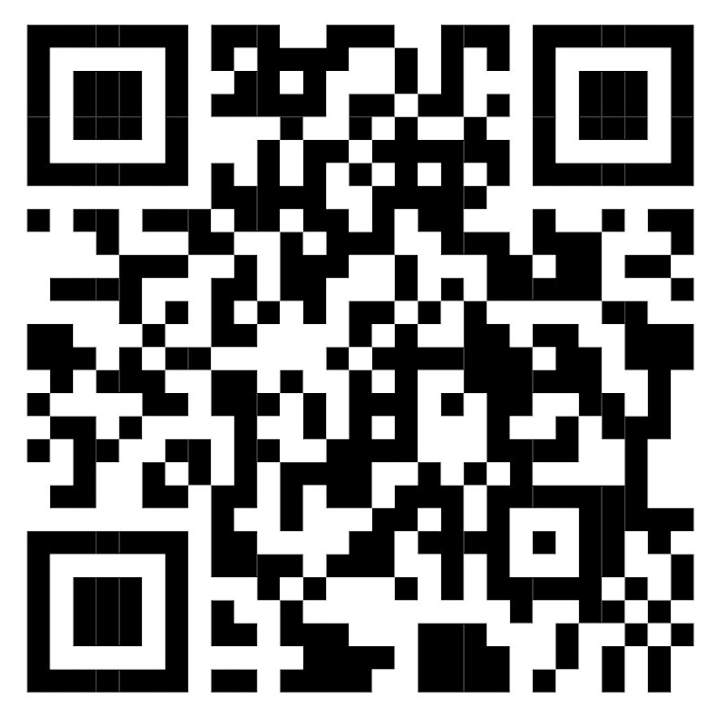
Parents & guardians, get signed up!
Scan this QR code or go to www.unifrog.org/student and click ‘Sign in for the first time’
You’ll be asked for some details and a Sign up Code. This is what you need:
Parentsholbeach
After signing up, log into Unifrog using your email address and password via the student sign-in page!

